Slide 1
Review Paycheck SUMMARY
JOB AID

Slide 2
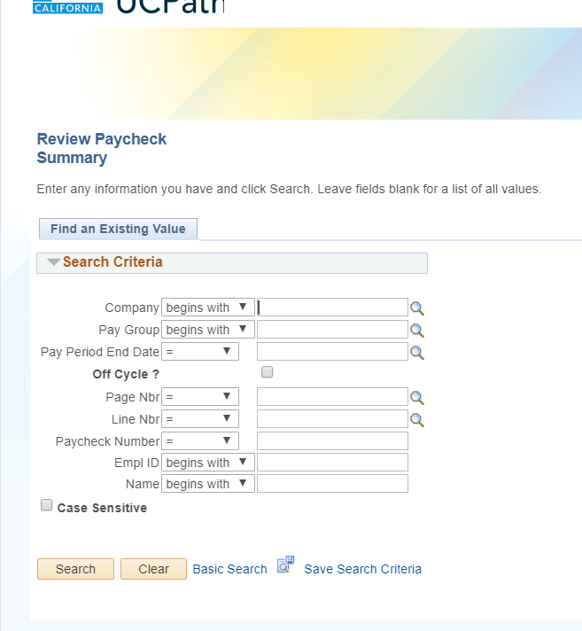
JOB AID: REVIEW PAYCHECK SUMMARY
How to Navigate to the Review Paycheck Summary Page
PeopleSoft Menu > Payroll for North America > Payroll Processing USA > Produce Payroll > Review Paycheck Summary
Once you navigate to Review Paycheck Summary, you can add it to your bookmarks and/or favorites.

Slide 3
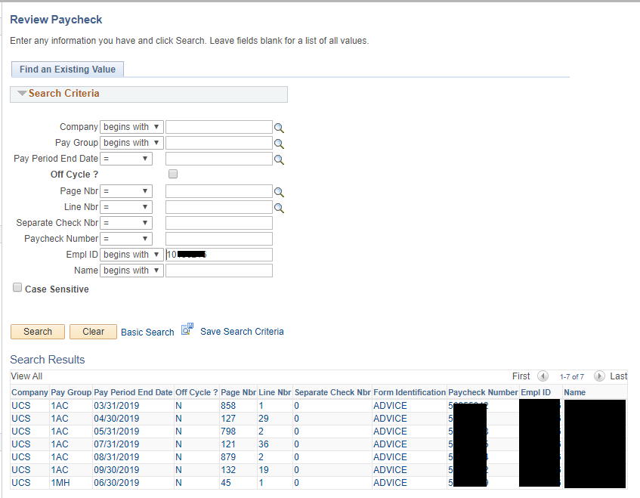
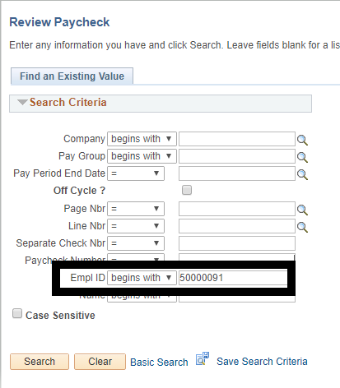
Once you enter the employee ID number and hit search, all paychecks will be available for you to click on to review, like the picture below. This employee has 7 paychecks in UCPath. We can see this is a Monthly Employee by Pay Group (1AC/1MH) and Pay Period End Date (Last day of the month).
Once you have navigated to the Review Paycheck Summary page, search for the employee by their employee ID number.
*Notes*
Pay Group: What pay group employee is paid on. This employee has two:
1AC = Academic Exempt Monthly
1MH = Hourly Exempt Monthly
Pay Period End Date – Last day of the pay period for the pay cycle.
Example: PPE 3/31/19 = Pay Period 3/1 – 3/31
Off Cycle? Was this paid on cycle or off cycle. N = on cycle, Y = Off cycle
Form Identification: Advice = Direct Deposit Check = Printed Check Mailed Out

Slide 4
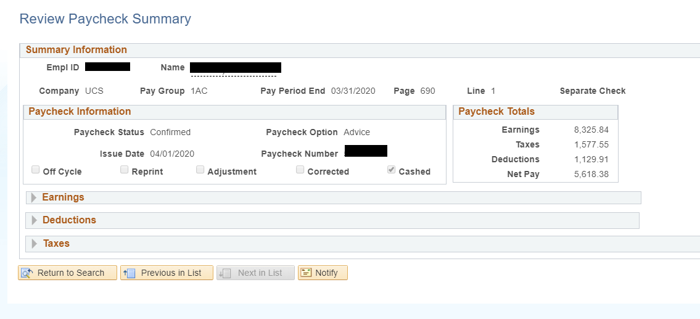
Once you have selected the check date you would like to review, you will see the check information come up, like in the picture below.
On the top of the check, you will see the Summary Information. Below this, you will see the Paycheck Information followed by the Earnings, Deductions and Taxes that you can expand to see more detailed information.
The Summary Information box shows the Employee ID Number, Name, Company, Pay Group, Pay Period End Date, Check Page, and Line.
Our first example is for a Monthly Employee.
Each component of this page will be discussed in following slides.

Slide 5
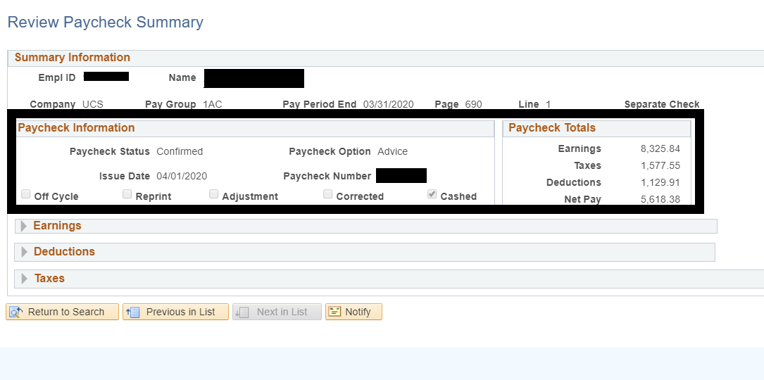
Monthly Employee
Paycheck Information Box
Paycheck Status: During payroll processing, the paycheck displays one of the following statuses:
Confirmed: Check is confirmed and complete; represents what was paid to the employee.
Reversing Check: Paycheck reflects an adjustment, which was made using the reversal process.
Calculated: Indicates the check is calculated, but not confirmed.
Paycheck Option: Indicated whether pay was issued via a Check or direct deposit.
Advice means that the employee’s pay was paid via direct deposit.
Check means that the employee will receive a paper check in the mail within 3-5 business days from the Issue Date.
Issue Date: Displays the date the paycheck was issued.
Paycheck Number: Displays the system-generated check or advice number after the pay confirmation process completes.
The boxes below issue date and paycheck number tell us the following:
Off cycle: Selected if the payment was processed in an off-cycle payroll (not on their regular scheduled pay date)
Reprint: UCPath is currently not using this check box
Adjustment: Selected if the original paycheck was reversed; data reflects the paycheck adjustment. Selected if this is part of the adjustment process.
Corrected: UCPath is currently not using this check box.
Cashed: Indicates the payroll files have been transmitted to the banks or for paper check, when it is cashed or deposited into their bank.
Our example tells us that this employee received their check via direct deposit on 4/01/20. The check has been confirmed and cashed.

Slide 6
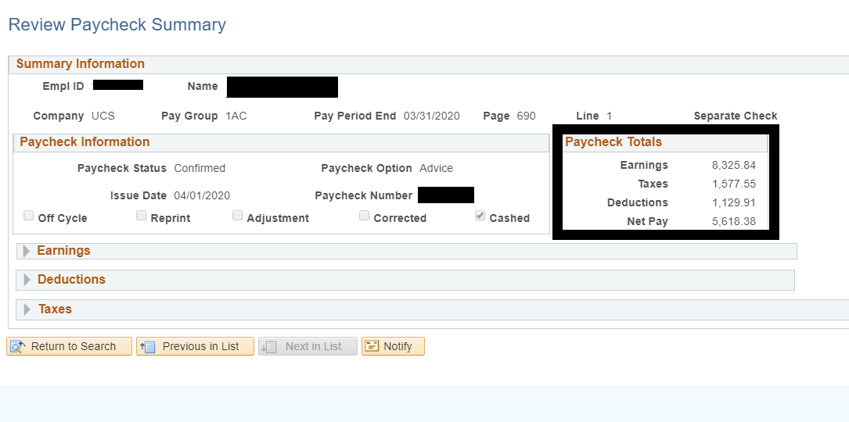
Monthly Employee
Paycheck Totals Box
The Paycheck Totals Section displays the employee’s total amounts.
Earnings: The total amount of gross earnings.
Taxes: The amount of taxes withheld from the employee’s paycheck. Includes only taxes the employee paid; does not include what the employer paid.
Deductions: The amount of deductions taken from the employee’s paycheck. Includes only deductions the employee paid; does not include what the employer paid.
Net Pay: The amount of net pay recorded on the employee’s paycheck; earnings less taxes and deductions.
Our example shows the employee’s Gross Earnings are $8,325.84 with $1,577.55 in taxes and $1,129.91 in deductions taken out, employee received $5,618.38 Net Pay.

Slide 7
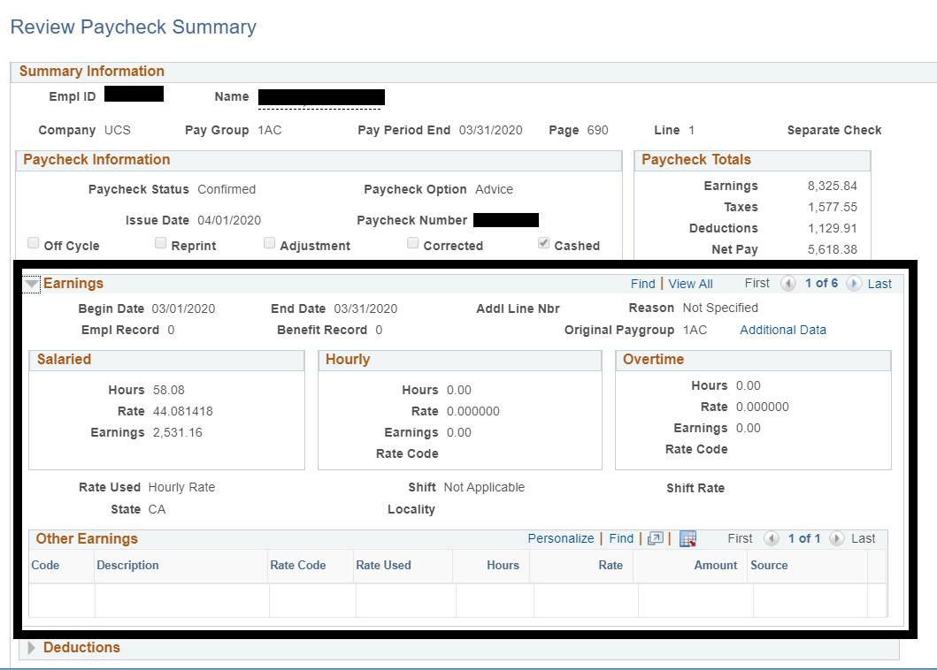
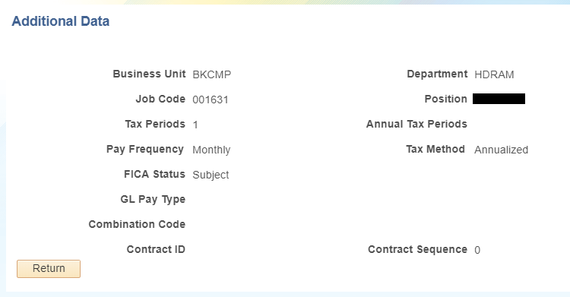
Monthly Employee
Earnings Box
Click the arrow next to Earnings to expand the Earnings section.
The Earnings section displays the fields related to paycheck earnings.
Begin Date/End Date: The first day/last day of the pay period. For monthly employees, the Begin Date and end Date indicate a one-month period, unless they are receiving pay for a portion of the month. For bi-weekly employees, an earnings row appears for each work day and the Begin Date is the same as the End Date. There may be additional earnings rows if the employee has additional pay. Use the View All, Show next row and Show previous row buttons to view each earnings row for a pay period.
Addl Line Nbr: Provides for multiple pay earnings row. Employees have at least one pay earnings line. When the pay earnings row covers an individual work day, the second earnings row is always an additional number.
Reason: Identifies the reason the employee is receiving additional pay. This field is for informational purposes only.
Empl Record: The employment record number reflects what job record the earnings are tied to.
Benefit Record: The benefit record number defaults to zero.
Additional Data: This link displays additional details related to paycheck earnings, such as Business Unit, Department, Job Code, Position, Tax Periods, Pay Frequency, Tax Method, and FICA Status.

Slide 8
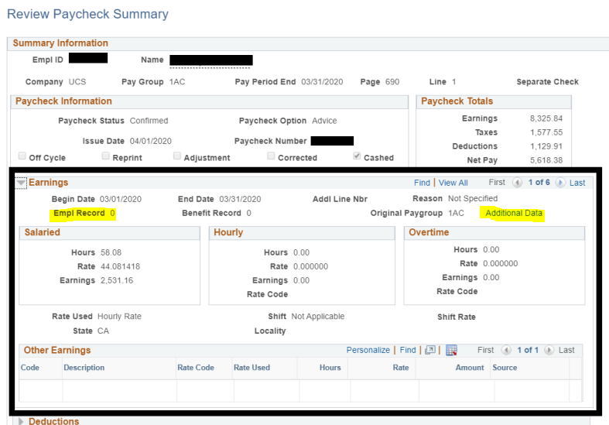
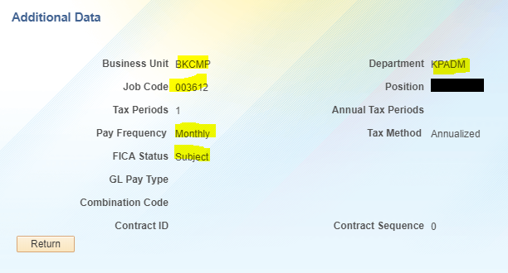
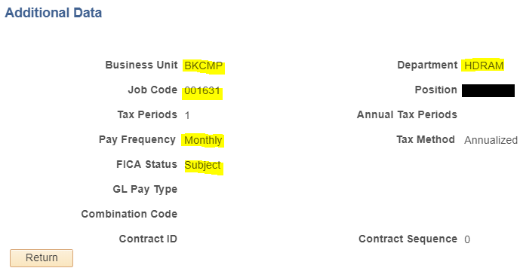
Monthly Employee
Earnings Box continued
Page 1 of 6
In our example, you can see the earnings for Page 1 of 6 is for Employee Record 0. When you click on Additional Data, you can view the above information. We can see that Record 0 is with the Department HDRAM on job code 001631.
Gross Earnings = $2,531.16 for Record 0
Empl Record 0

Slide 9
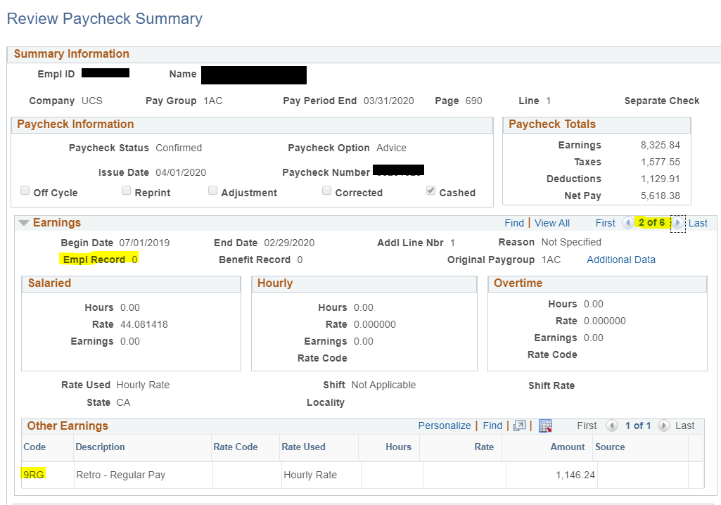
Monthly Employee
Earnings Box continued
Page 2 of 6
In our example, we are now viewing Page 2 of 6. This page shows that the employee is receiving retro pay from the timeframe of 7/1/19 – 2/29/20 for Empl Record 0. When you click on Additional Data, you can view the above information, which is the same as before because it is still on record 0.
Earn Code 9RG for Regular Retro Pay on Emp Record 0
Retro pay in the amount of $1,146.24

Slide 10
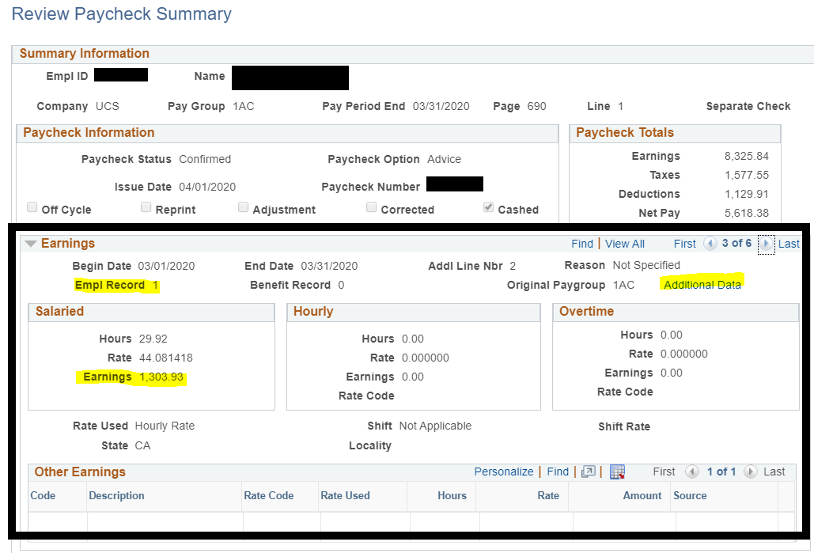
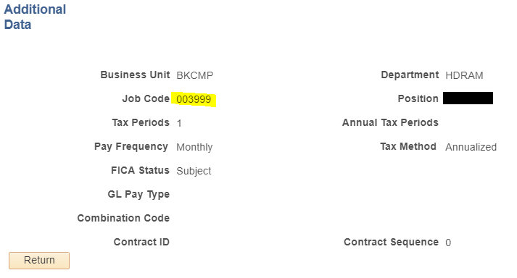
Monthly Employee
Earnings Box continued
Page 3 of 6
In our example, we are now viewing Page 3 of 6. This page shows that the employee earned regular earnings in the amount of $1,303.93 for their job on Record 1 for 3/1 – 3/31. When you click on Additional Data, you can view the above information. You can see Record 0 and Record 1 are both with the same department HDRAM, but the Job Code is different.
Empl Record 1
Earnings for record 1 in the amount of $1.303.93

Slide 11
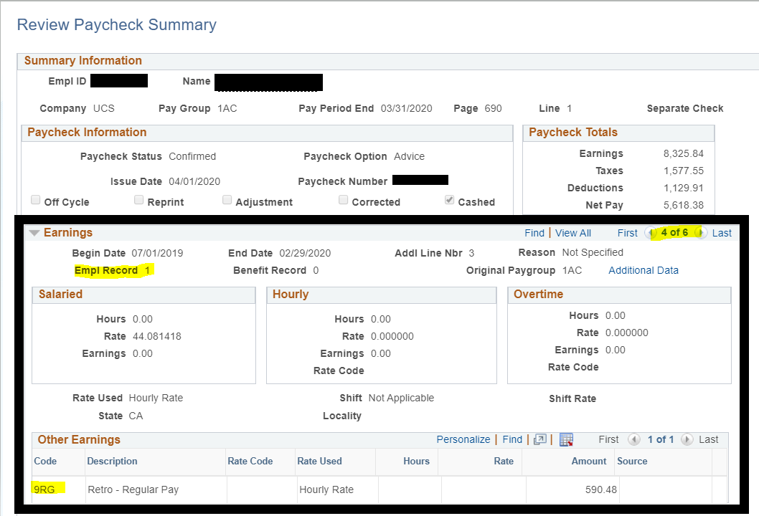
Monthly Employee
Earnings Box continued
Page 4 of 6
In our example, we are now viewing Page 4 of 6. This page shows that the employee is receiving retro pay from the timeframe of 7/1/19 – 2/29/20 for Empl Record 1. When you click on Additional Data, you can view the above information, which is the same as before because it is still on record 1.
Earn Code 9RG for Regular Retro Pay on Empl Record 1
Retro pay in the amount of $590.48

Slide 12
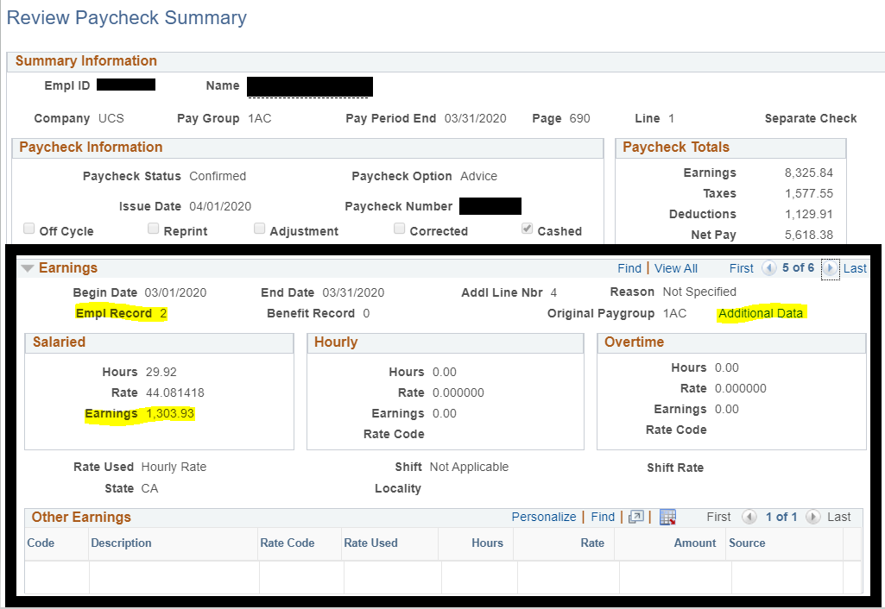
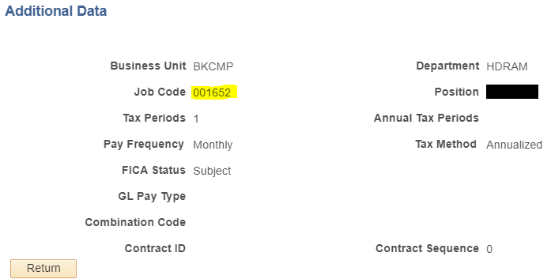
Monthly Employee
Earnings Box continued
Page 5 of 6
In our example, we are now viewing Page 5 of 6. This page shows that the employee earned regular earnings in the amount of $1,303.93 for their job on Record 2 for 3/1 – 3/31. When you click on Additional Data, you can view the above information. You can see all 3 records are with the same department HDRAM, but the Job Code is different.
Empl Record 2
Earnings for record 2 in the amount of $1.303.93

Slide 13
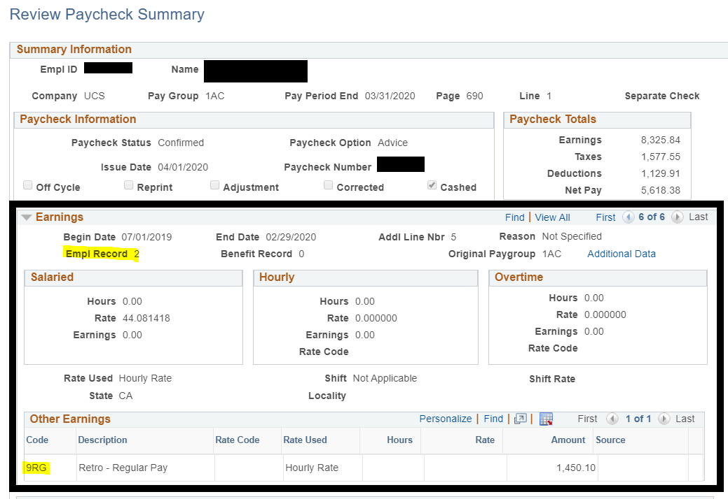
Monthly Employee
Earnings Box continued
Page 6 of 6
In our example, we are now viewing Page 6 of 6. This page shows that the employee is receiving retro pay from the timeframe of 7/1/19 – 2/29/20 for Empl Record 2. When you click on Additional Data, you can view the above information, which is the same as before because it is still on record 2.
Earn Code 9RG for Regular Retro Pay on Emp Record 2
Retro pay in the amount of $1,450.10

Slide 14
Monthly Employee
Earnings Box continued
When there is a change in pay on the employee’s record, this triggers the retro module at UCPath. (For post conversion dates only)
UCPath will automatically calculate the retro amount due and pay on the next available scheduled check date.
The total amount of retro pay that the employee received on this check was $3,186.82 from Record 0, Record 1 and Record 2.
Going back to the paycheck totals in the picture above; we see that gross earnings were $8,325.84 and when we add all of the earnings together from pages 1-6, it equals the total gross earnings in Paycheck Totals box of $8,325.84
($2,531.16 + $1,146.24 + $1,303.93 + $590.48 + $1,303.93 + $1,450.10 = $8,325.84)

Slide 15
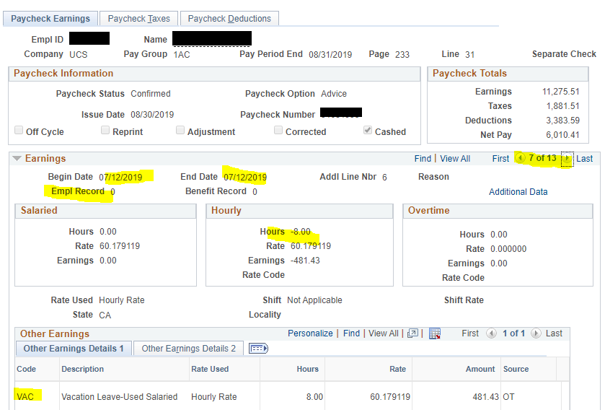
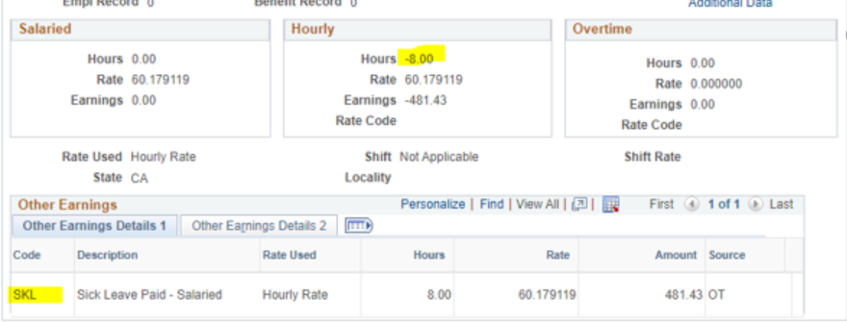
Monthly Employee
Earnings Box Additional Information***
When a Monthly Employee uses vacation or sick leave usage, it will show up on review paycheck summary as shown to the left. You will see the earn code VAC (Vacation usage) or SKL (Sick usage) and the number of hours used. You will see negative hours in the Hourly Box that shows the hours being deducted from their vacation balance.
The employee is not being paid out the amount shown because they were already paid for these hours on their previous paycheck. You can add up the earnings from all other pages to see that the earnings are not being added.
For a complete list of all earn codes UCPath uses, please visit: https://bfs.ucr.edu/sites/g/files/rcwecm751/files/2019-08/earn_codes_complete_list_report_20190719.pdf

Slide 16
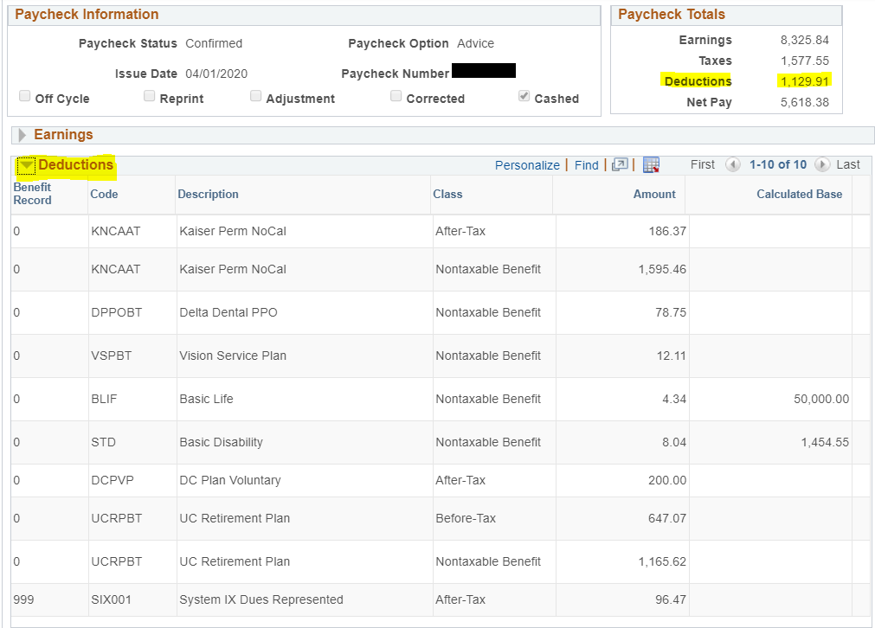
Monthly Employee
Paycheck Deductions
Click the arrow next to Deductions to expand this section.
Deduction Details includes:
Deduction Code: Displays the benefit or non-benefit deduction code.
Description: Displays the description of the deduction.
Class: This column displays the tax classification assigned to the deduction. For benefit deductions there may be multiple tax classifications assigned for one deduction displayed on multiple rows in the Deduction section.
Amount: The total deduction amount for the tax class.
Calculated Base: This column displays the base amount used to determine the deduction amount. This can be a coverage amount of a calculated amount. Note that the coverage amount may be limited by a coverage gap.

Slide 17
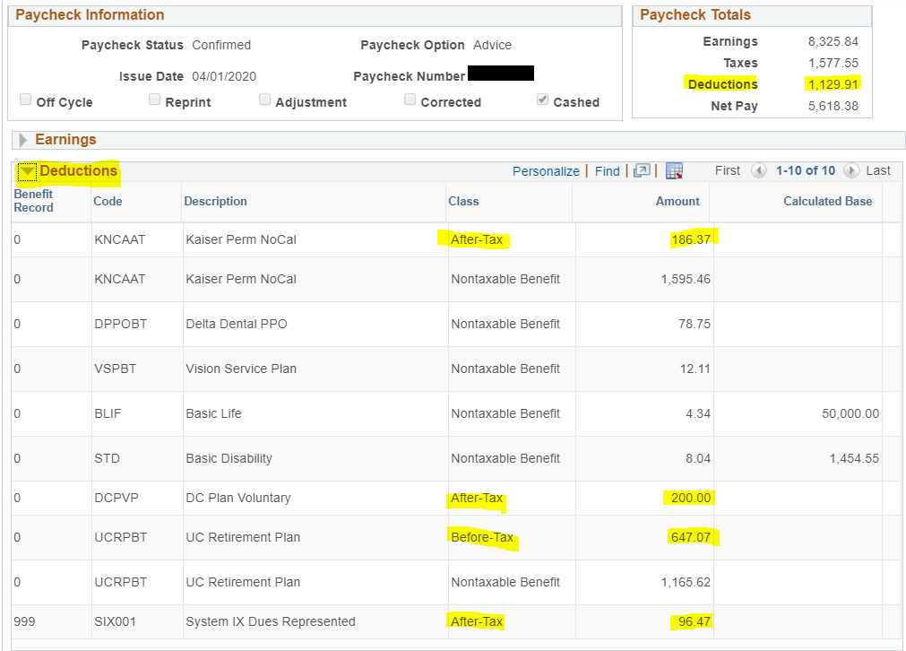
Monthly Employee
Paycheck Deductions continued
To calculate the total deductions taken out of the employee’s check, you would add up the amounts except for the “Nontaxable Benefits” in the Class column.
Example: Add up all of the Before-Tax and After-Tax
$186.37 + $200.00 + $647.07 + $96.47= $1129.91

Slide 18
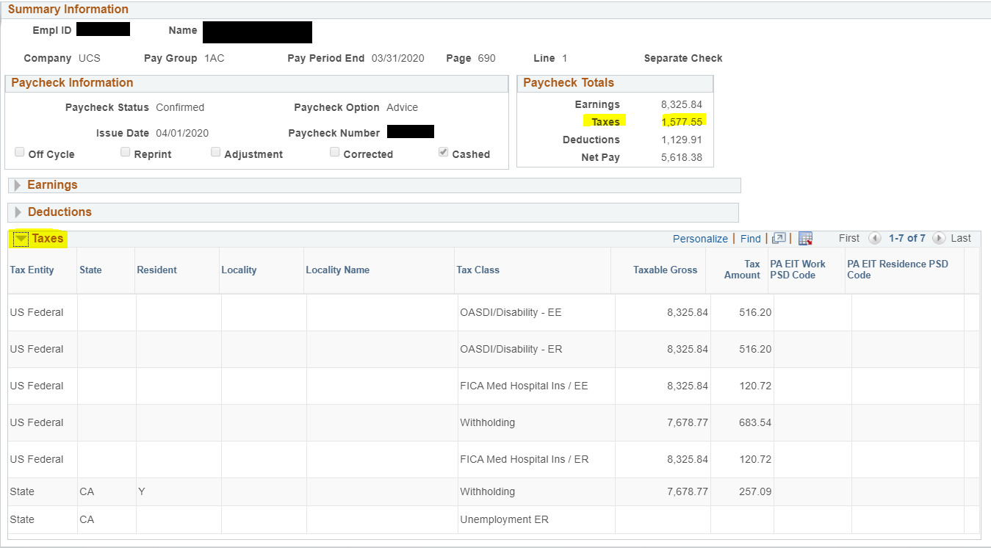
Monthly Employee
Paycheck Taxes
Tax Details Section:
Tax Details 1 shows the following info:
Tax Entity: Indicates the taxing authority: US Federal, State, or Local
State: The state abbreviation code appears in Tax Entity is State.
Resident: A Y appears on the state withholding tax line for the employee’s state of residence. The value defaults from the State Tax page.
Locality/Locality Name: Displays the code and name of the local taxing authority when Tax Entity is Local.
Tax Class: Displays the code for the type of tax. The amounts paid by the employee and the employer are presented. The letters EE at the end of the code indicate an employee-paid tax and the letters ER indicate an employer-paid tax.
Taxable Gross: Displays the taxable gross earnings for the specified tax class. Taxable gross takes into consideration any maximum limit imposed for the specified tax class.
Tax amount: Displays the amount of taxes for a particular tax class.
Total Taxes deducted: $1,577.55
In our example, the employee is paying taxes in CA, is a resident of CA and is paying US Federal and State taxes. The employee’s total taxes are $1577.55 which includes the MED/EE, OASDI/EE, and both Fed and State Withholding lines. ($516.20+$120.72+$683.54+$257.09 = $1577.55)

Slide 19
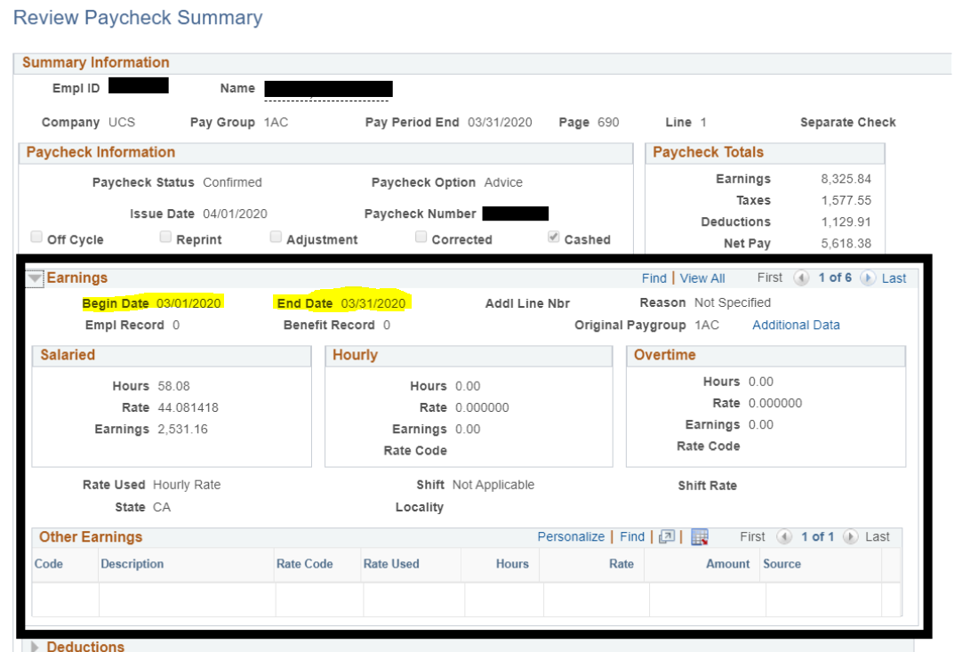
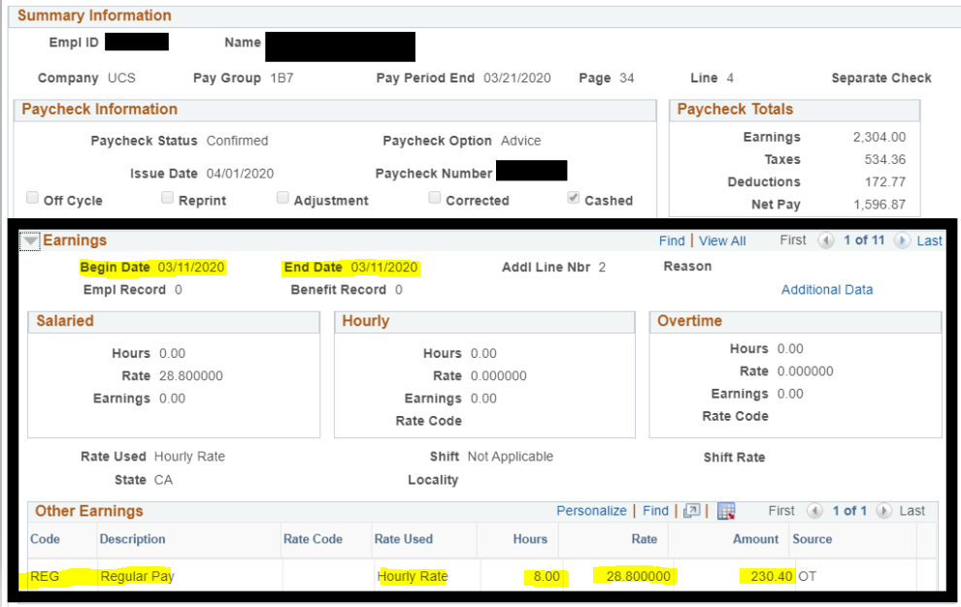
Biweekly Employee
Biweekly Paycheck
Now we will take a quick look at a Biweekly Pay Period paycheck. For our monthly employee, we saw a monthly compensation, with the begin and end date reflecting the whole month as shown below.
For Biweekly employees, we will see hours reported day by day, with daily earnings. The Pay Group is 1BH, because this employee is paid Biweekly/Hourly. The Pay Period End is 3/21/20, reflecting the end of the period 3/8/20 – 3/21/20 with a check date of 4/1/20.
Monthly Paycheck
Biweekly Paycheck

Slide 20
Biweekly Employee
Biweekly Paycheck
The first page of earnings is showing the Begin and End date of 3/11/20. On this date, the employee worked a total of 8 hours. Their hourly rate is $28.80 per hour, totaling to the amount of $230.40 gross for this day.

Slide 21
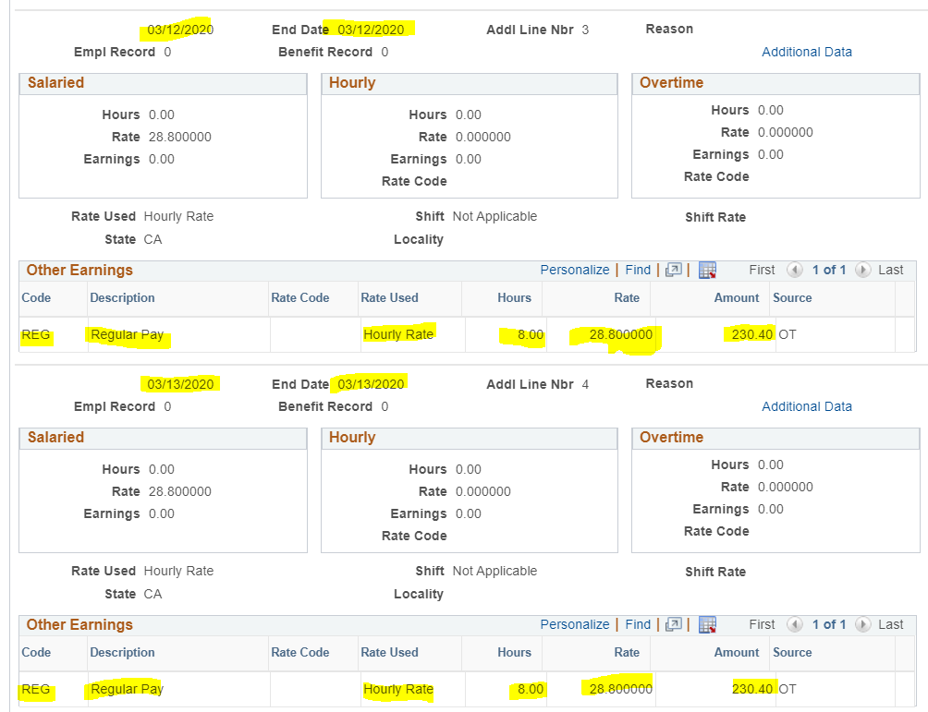
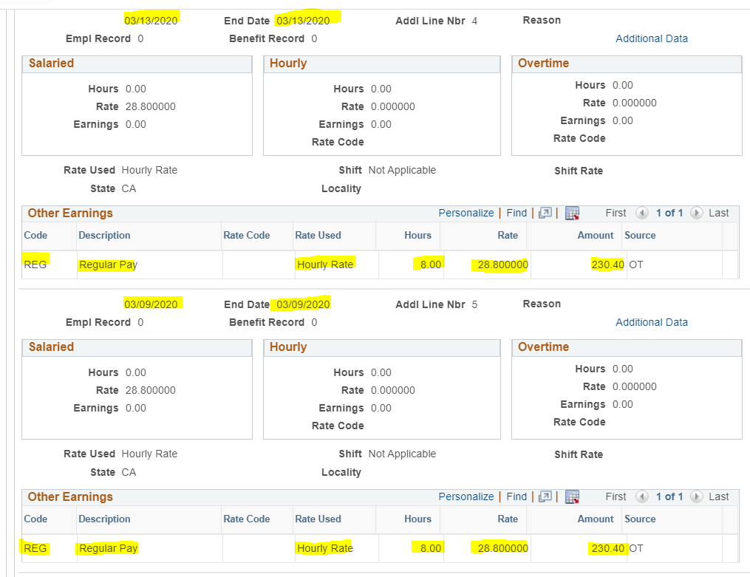
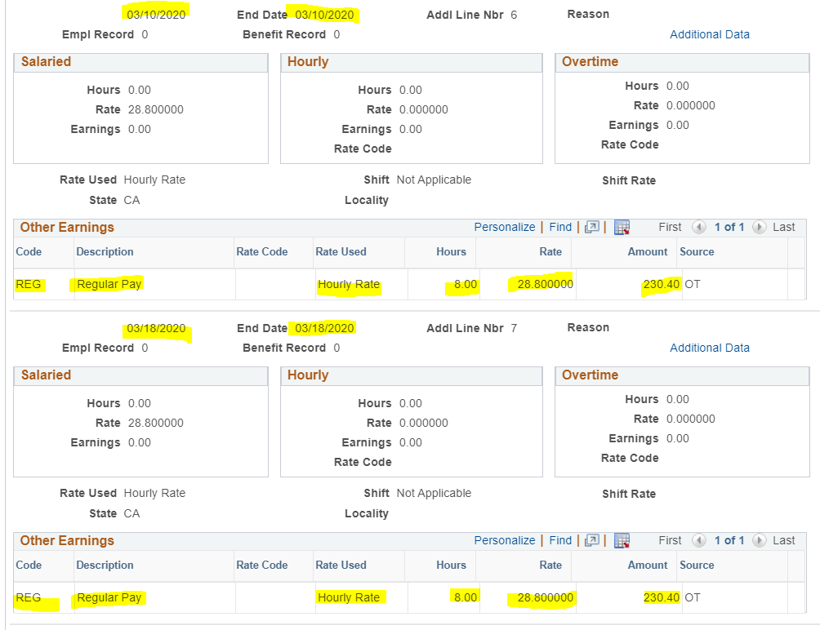
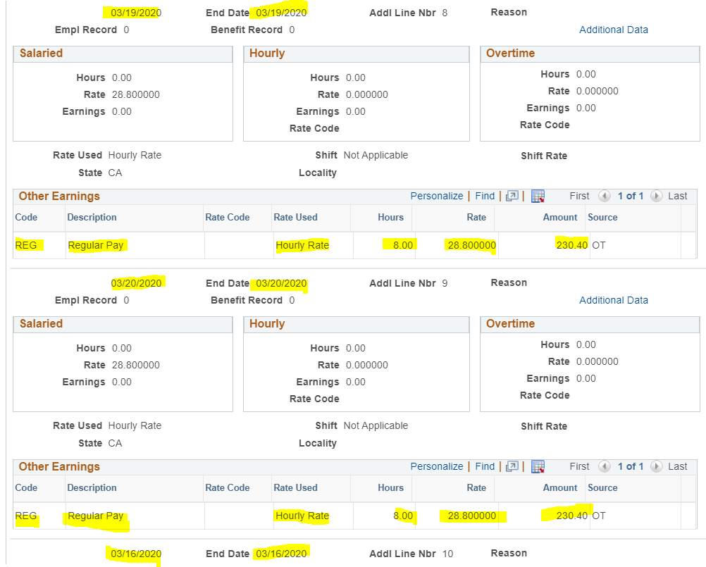
Biweekly Employee
Biweekly Paycheck continued
Pages 2 – 9 show the earnings for days worked from 3/9–3/16. On these dates, the employee also worked a total of 8 hours for each day. Their hourly rate is $28.80 per hour, totaling to the amount of $230.40 gross for each of these days.
*Note* Days worked are not always in order, as you can see, 3/9 shows up after 3/13.
The next slide will show the last 2 pages of their check.

Slide 22
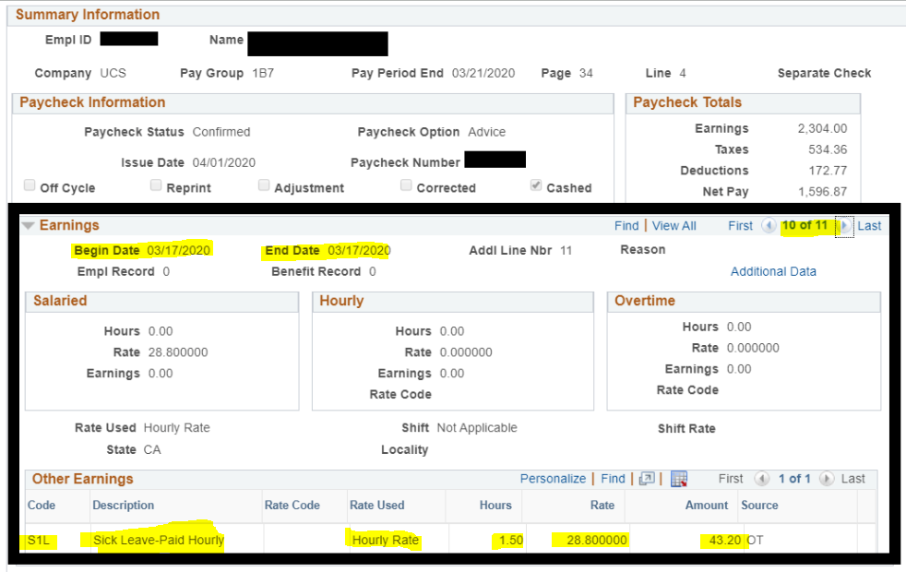
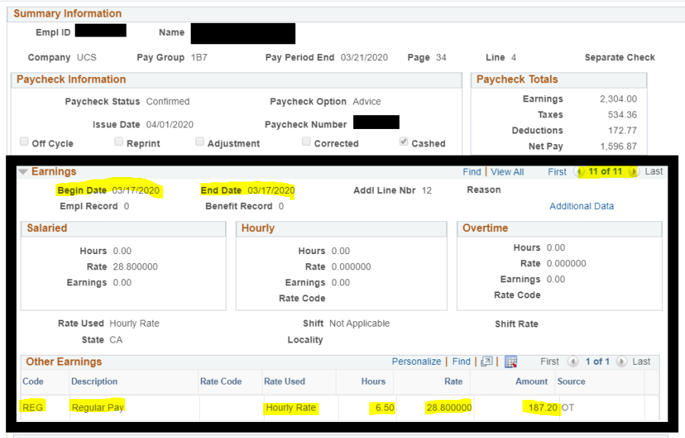
Biweekly Employee
Biweekly Paycheck continued
Page 10 of 11 is showing the begin and end date of 3/17/20. The employee used 1.50 hours of sick leave on this day. The earn code is S1L for hourly employees. The employee was paid at their current hourly rate of $28.80 for 1.50 S1L for a total of $43.20 for 3/17/20.
Page 11 of 11 is showing the begin and end date of 3/17/20 as well. The employee worked 6.50 hours on this day, with a rate of $28.80/hr, totaling $187.20 of REG earnings for 3/17/20.

Slide 23
Biweekly Employee
Biweekly Paycheck continued
Our Biweekly employee example reported 10 days worked for the pay period ending 3/21/20. For biweekly staff employees who work full time, they will typically have at least 10 pages of regular pay. Additional pages could include vacation or sick time used, retro pay owed, etc. Our employee has 11 pages for this pay period due to using sick time for one day. Leave usage will show up on its own page. Late timesheets processed for the next scheduled pay date will also result in more pages in the earnings section. There are many factors why there would be additional pages under earnings.
All other sections and tabs on a biweekly employee’s paycheck are viewed the same as monthly, covered in previous slides. (Taxes and Deductions)

Slide 24
If you still have questions on reviewing paychecks, you can reach out to share_payroll@berkeley.edu
Please visit https://bfs.ucr.edu/sites/g/files/rcwecm751/files/2019-08/earn_codes_complete_list_report_20190719.pdf for a list of all earn codes used in UCPath
THANK YOU!

